Slide 1
Probability Theory
The Birthday
Paradox
When Probability Defies Intuition
Mathematical Exploration
Probability & Statistics

Slide 2
Overview
Contents
01
What is the Birthday Paradox?
02
The Mathematics Behind
Understanding the counterintuitive probability phenomenon that challenges our intuition
How the probability is calculated step by step using complementary approach
03
Why Our Intuition Fails
04
Real-World Applications
Understanding the psychological traps and cognitive biases at play
Where the birthday paradox matters in cryptography and beyond

Slide 3
Chapter One
What is the
Birthday Paradox?
01
Understanding the counterintuitive probability phenomenon

Slide 4
The Core Question
The Surprising Question
How many people must be in a room for there to be a greater than 50% chance that at least two of them share the same birthday?
Intuitive Guess
Actual Answer
~180
23
people
people
Most people assume you need about half the days in a year—seems logical, right?
Just 23 people gives you a 50.7% probability of a shared birthday. This is why it's called a paradox.
The paradox: The result seems wrong but is mathematically proven true.

Slide 5
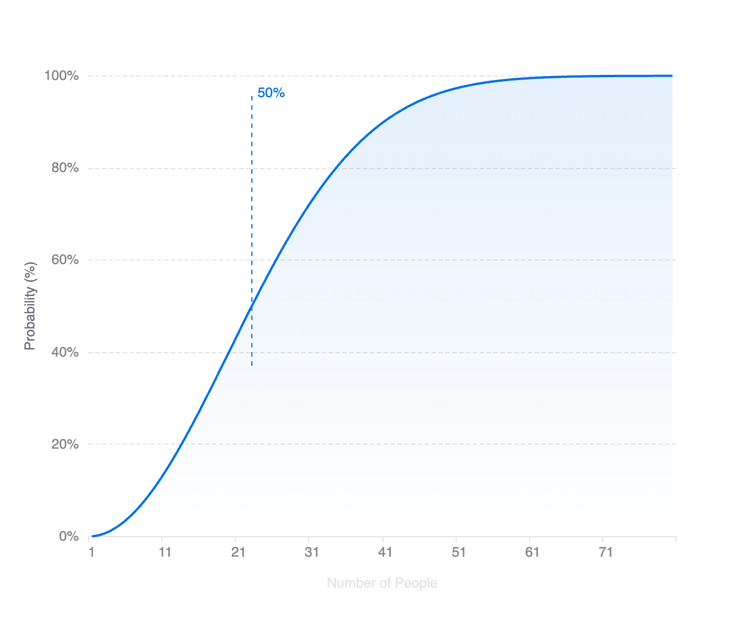
Probability Distribution
Key Probability Milestones
23
people
50.7%
The 50-50 threshold
30
people
70.6%
50
people
97.0%
60
people
99.2%
75
people
99.9%
Virtually guaranteed

Slide 6
Notes:
The birthday paradox illustrates how human intuition about probability often fails when dealing with combinatorial problems.

Slide 7
Chapter Two
The Mathematics
Behind
02
How the probability is calculated step by step

Slide 8
Mathematical Strategy
The Complementary Approach
Instead of calculating the probability of at least one match directly, we calculate the probability of no matches and subtract from 1.
P(match) = 1 − P(no match)
Why This Works
The Advantage
There are only two possibilities: either at least two people share a birthday, or everyone has unique birthdays.
Calculating "no matches" is much easier because we can build it step by step, person by person.
These are complementary events, so their probabilities must sum to 1 (or 100%).
This sequential approach makes the complex problem tractable.
Key insight: This complementary approach is a fundamental technique in probability theory.

Slide 9
Step-by-Step
Building the Calculation
1
First person enters
Probability of unique birthday: 365/365 = 1
2
Second person enters
Probability of different birthday: 364/365
3
Third person enters
Probability of different birthday: 363/365
...
Pattern continues...
23
23rd person enters
Probability of different birthday: 343/365
The Complete Formula
P(no match) = (365/365) × (364/365) × (363/365) × ... × (343/365)
P(at least one match) = 1 − 0.493 = 0.507 (50.7%)

Slide 10
The Key Insight
The Power of Combinations
With 23 people, we're not making 23 comparisons. We're making 253 comparisons—every possible pair of people.
10
people
45 pairs
23
people
Number of Pairs Formula
C(n,2) = n × (n−1) / 2
253 pairs
For n = 23: 23 × 22 / 2 = 253 pairs
More than half the days in a year!
50
people
1,225 pairs
The crucial insight: While the probability for any single pair is low (1/365 ≈ 0.27%), having 253 chances makes a match likely. This is why combinations grow quadratically (n²), not linearly.

Slide 11
Chapter Three
Why Our
Intuition Fails
03
Understanding the psychological traps

Slide 12
Cognitive Bias
The Self-Reference Trap
We naturally think about "someone sharing MY birthday" rather than "any two people sharing a birthday." This subtle shift in perspective completely changes the mathematics.
Scenario A: Matching YOUR Birthday
Scenario B: Any Two People Match
253 people
23 people
needed for 50% probability
needed for 50% probability
Each person has a 1/365 chance of matching your specific birthday.
With 23 people, there are 253 unique pairs, each a potential match.
This is what our intuition expects—and it feels right.
This is the actual birthday paradox—and it feels wrong.
The psychological trap: We're wired to think about ourselves as the reference point, not the entire group's pairwise combinations.

Slide 13
Cognitive Limitation
Exponential Growth vs. Linear Thinking
Human brains struggle with exponential growth. We expect probabilities to scale linearly, but combinations grow quadratically (n²).
How We Think (Linear)
How It Actually Works (Quadratic)
10 people
10 people
45 pairs
20 people
23 people
253 pairs
30 people
50 people
1,225 pairs
Our intuition expects probability to increase proportionally with group size.
The number of pairs explodes quadratically, making matches inevitable.
The compounding effect: Each new person doesn't just add one comparison—they add comparisons with everyone already in the room. This is why the probability curve rises so steeply.

Slide 14
Chapter Four
Real-World
Applications
04
Where the birthday paradox matters in practice

Slide 15
Cybersecurity
Cryptography: The Birthday Attack
The birthday paradox isn't just a mathematical curiosity—it has serious implications for digital security.
MD5 (128-bit)
2^64 attempts
for 50% collision chance
Hash functions are used to verify data integrity. Finding two inputs that produce the same hash (a collision) follows the same mathematics as the birthday paradox.
SHA-1 (160-bit)
2^80 attempts
This vulnerability is exploited in "birthday attacks" to forge digital signatures and compromise security systems.
for 50% collision chance
SHA-256 (256-bit)
2^128 attempts
for 50% collision chance
Why This Matters
Digital Signatures
Data Integrity
Security Design
Attackers can forge signatures by finding colliding documents.
Malicious data can be substituted without detection.
Hash functions need twice the expected bit length for security.

Slide 16
Broader Impact
Other Practical Applications
Insurance & Risk
Understanding Coincidences
Marketing Analytics
Actuaries use similar probability models to assess risk pools and calculate premiums for group policies.
Helps explain why seemingly improbable coincidences happen more often than we expect in daily life.
Used to analyze audience overlap and optimize ad targeting across different platforms and campaigns.
Social Networks
DNA Analysis
Random Sampling
Powers friend suggestion algorithms by calculating the probability of shared connections in large networks.
Used in forensic science to calculate the probability of DNA profile matches in large databases.
Informs the design of statistical sampling methods and quality control processes in manufacturing.
Universal principle: The mathematics of the birthday paradox appears wherever we need to understand collision probabilities in large sets.

Slide 17
Conclusion
Key Takeaways
1
The Surprising Number
2
The Real Culprit
Only 23 people are needed for a 50.7% chance of a shared birthday—far fewer than intuition suggests.
The paradox arises from counting all possible pairs (253 with 23 people), not just comparing to one person.
3
Intuition's Blind Spot
4
Real-World Impact
Our brains think linearly, but combinations grow quadratically. We underestimate exponential growth.
This mathematics underlies birthday attacks in cryptography, affecting digital security worldwide.
"The birthday paradox reminds us that intuition is a poor guide to probability."
The Birthday Paradox
— A lesson in mathematical thinking
Probability Theory & Applications

